Slide 1

Deep Learning
Session 10 and 11
Convolutional Neural Networks (CNNs)
Applied Data Science
2024/2025

Slide 2
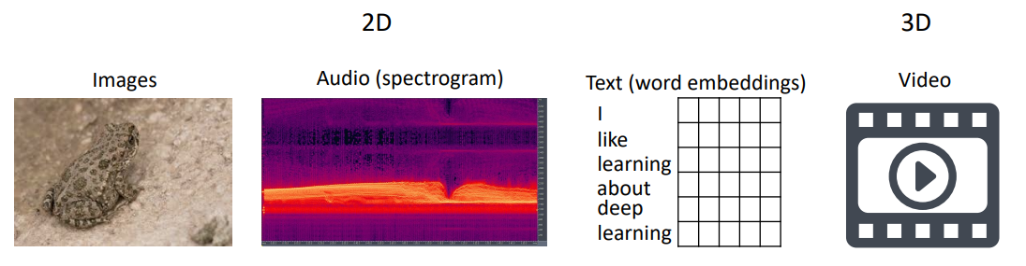
Spatial Data
Definition: Spatial data refers to data where the arrangement or location of elements is important.
Convolutional Neural Networks
Session 10

Slide 3
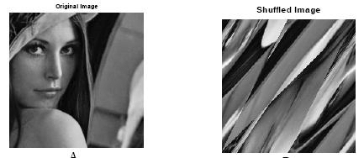
Why Spatial Structure Matters?
Local Patterns: In spatial data, nearby elements (e.g., pixels) often have strong relationships.
Example: Edges, textures, and objects in an image are defined by neighboring pixel values.
Context Preservation: Spatial arrangement helps capture context.
Example: In an image, nearby pixels form features like eyes, while distant pixels represent unrelated parts (e.g., background).
Convolutional Neural Networks
Session 10

Slide 4
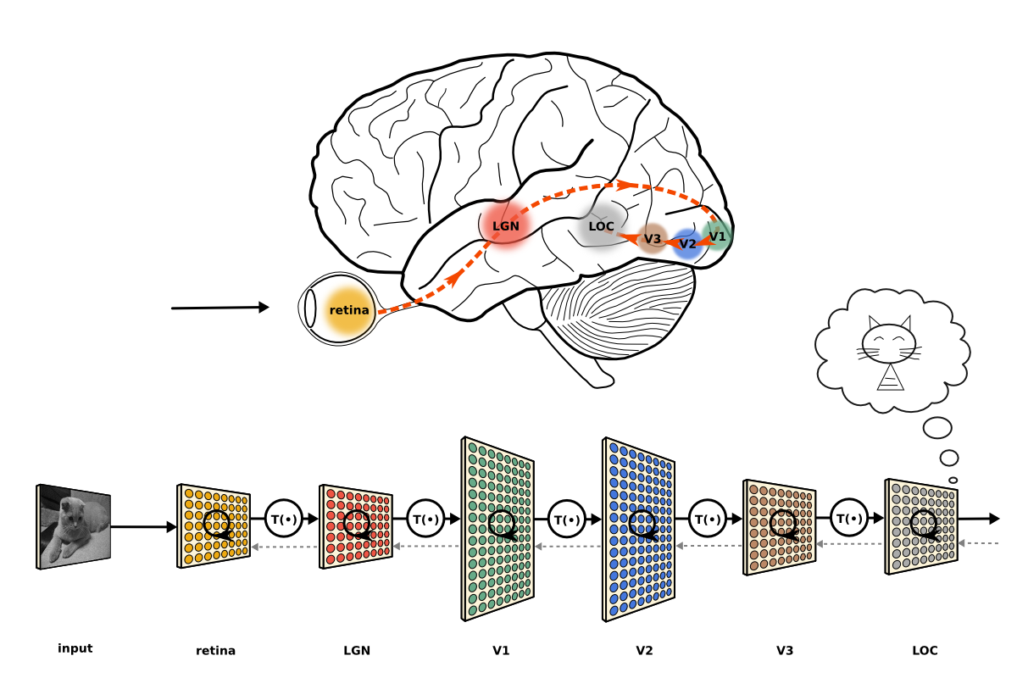
Motivation: How Vision Systems Work
de-Wit, L. H., Kubilius, J., de Beeck, H. P. O., & Wagemans, J. (2013). Configural Gestalts Remain Nothing More Than the Sum of Their Parts in Visual Agnosia. In i-Perception (Vol. 4, Issue 8, pp. 493–497). SAGE Publications. https://doi.org/10.1068/i0613rep
Convolutional Neural Networks
Session 10

Slide 5
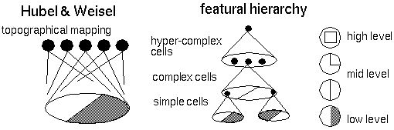
Motivation: How Vision Systems Work
Key Idea: cells are organized as a hierarchy of feature detectors, with higher level features responding to patterns of activation in lower level cells
Convolutional Neural Networks
Session 10

Slide 6
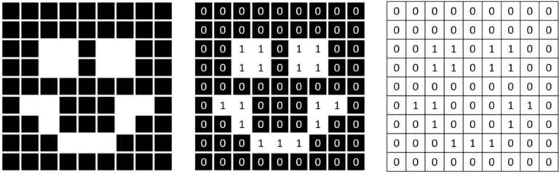
What computers "see"?
Images are Numbers
Binary Images
Convolutional Neural Networks
Session 10

Slide 7
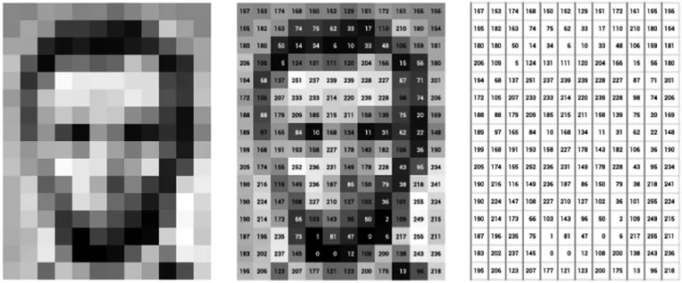
What computers "see"?
Images are Numbers
Greyscale Images
Convolutional Neural Networks
Session 10

Slide 8
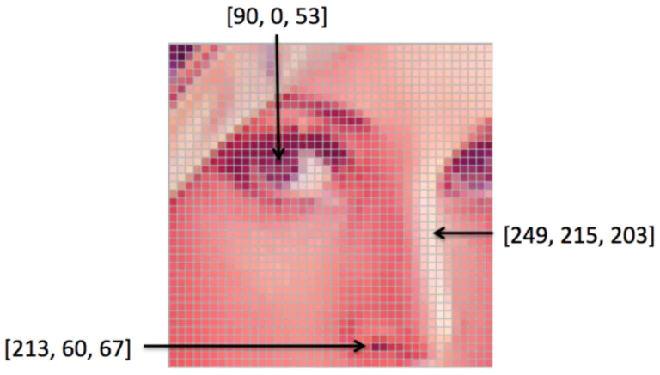
What computers "see"?
Images are Numbers
Color Images
Convolutional Neural Networks
Session 10

Slide 9

Neocognitron
“In this paper, we discuss how to synthesize a neural network model in order to endow it an ability of pattern recognition like a human being… the network acquires a similar structure to the hierarchy model of the visual nervous system proposed by Hubel and Wiesel.”
- Fukushima, Neocognitron: A Self-organizing Neural Network Model for a Mechanism of Pattern Recognition Unaffected by Shift in Position. Biological Cybernetics, 1980.
Convolutional Neural Networks
Session 10

Slide 10
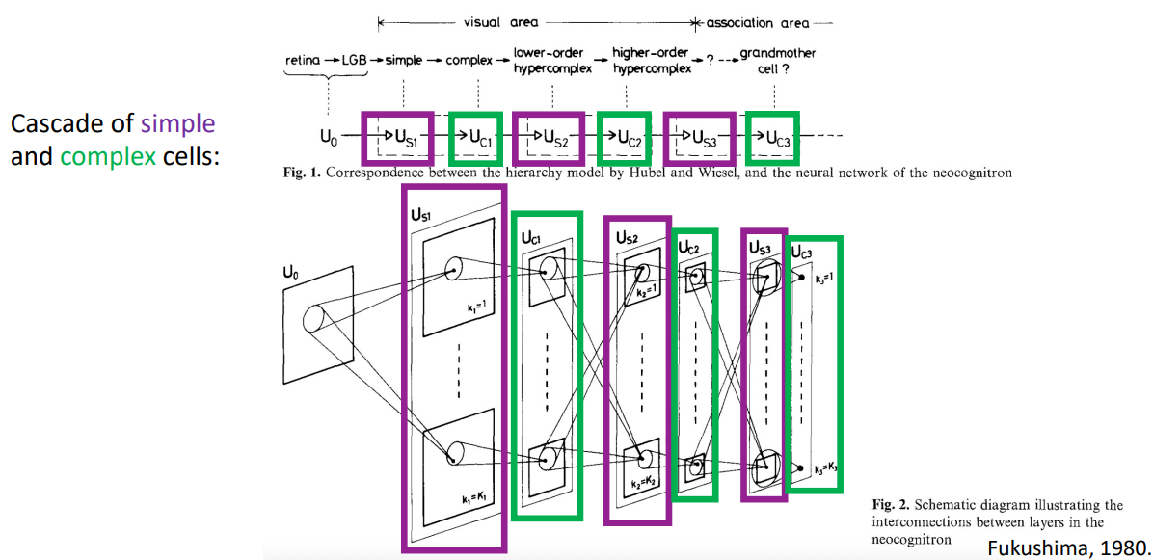
Neocognitron
Convolutional Neural Networks
Session 10

Slide 11
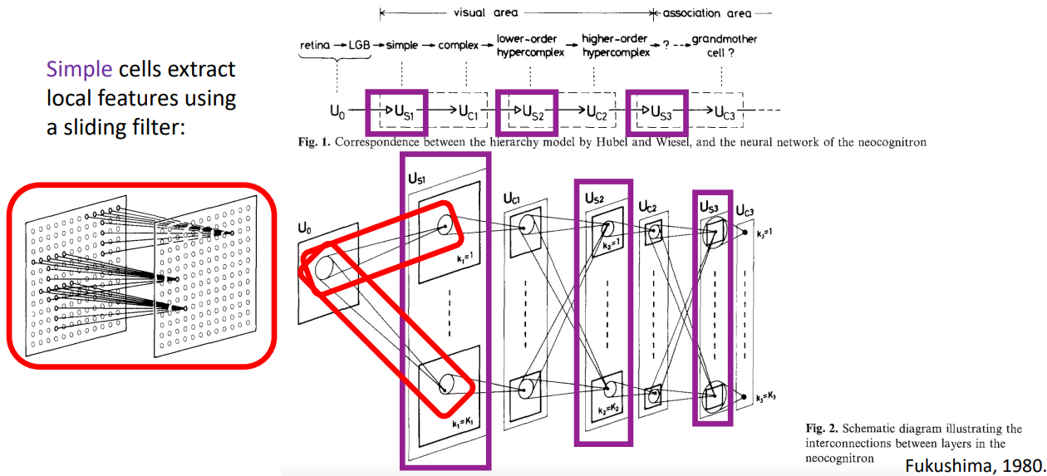
Neocognitron
Convolutional Neural Networks
Session 10

Slide 12
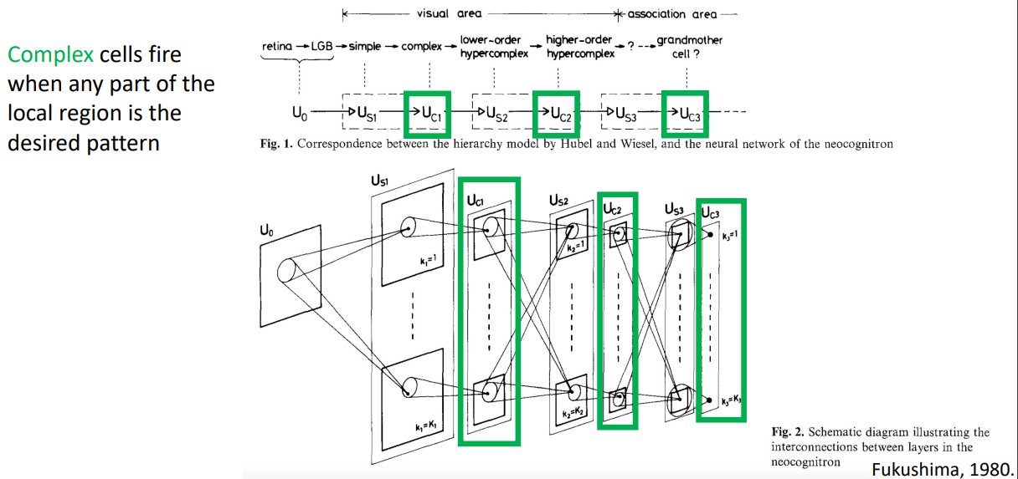
Neocognitron
Convolutional Neural Networks
Session 10

Slide 13
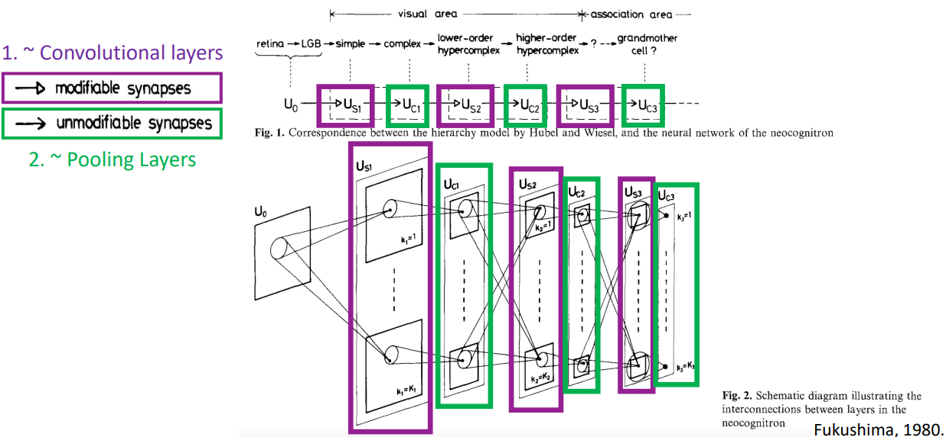
Neocognitron
Convolutional Neural Networks
Session 10

Slide 14
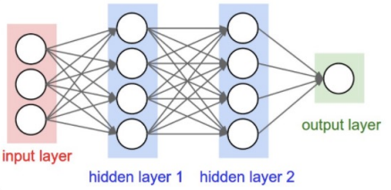
Challenges of Fully Connected Networks
Fully-Connected Layers are Limited
Each node provides input to each node in the next layer.
No spatial information!
Convolutional Neural Networks
Session 10

Slide 15
Challenges of Fully Connected Networks
Assume 2 layer model with 100 nodes per layer
e.g., how many weights are in a colored 640x480 image?
Convolutional Neural Networks
Session 10

Slide 16
Challenges of Fully Connected Networks
Assume 2 layer model with 100 nodes per layer
e.g., how many weights are in a colored 640x480 image?
640x480x3x100 + 100x100 + 100x1 = 92,170,100
e.g., how many weights are in a 2048X1536 image (3.1 Megapixel image)?
2048x1536x3x100 + 100x100 + 100x1 = 943,728,500
Convolutional Neural Networks
Session 10

Slide 17
Challenges of Fully Connected Networks
Issue: many model parameters in fully connected networks
Many model parameters and so...
Greater chance to overfit
Increased training time
Needs more training data
Convolutional Neural Networks
Session 10

Slide 18
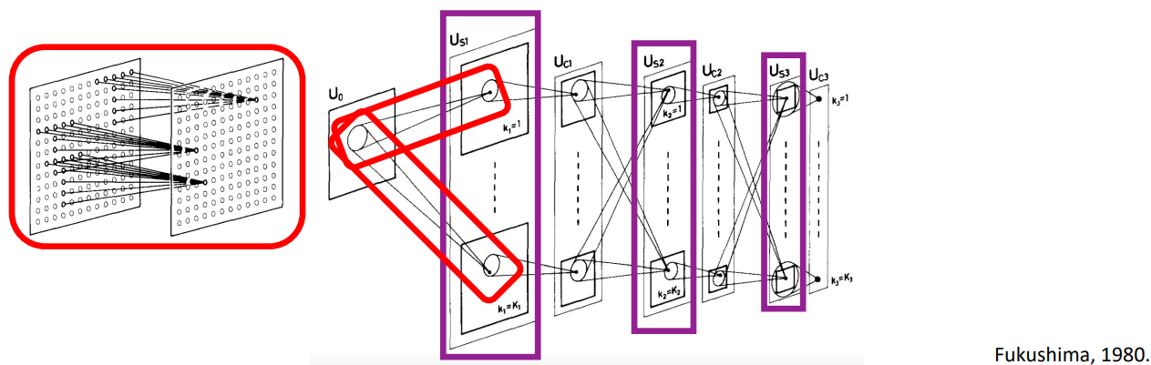
Convolutional Layers
Idea: each node receives input only from a small neighborhood in previous layer and parameter sharing
Neocognitron
Convolutional Neural Networks
Session 10

Slide 19
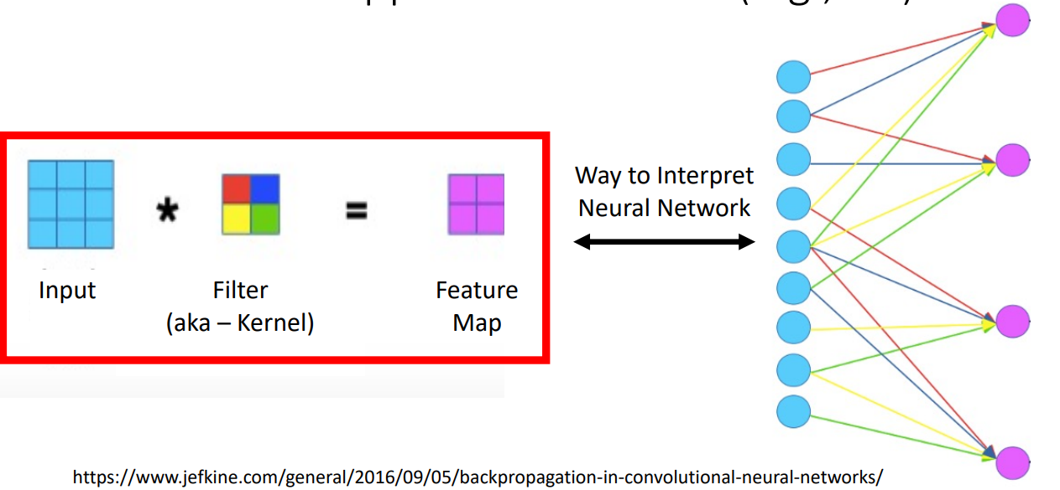
Convolution
Applies a linear filter (e.g., 2D)
https://www.jefkine.com/general/2016/09/05/backpropagation-in-convolutional-neural-networks/
Convolutional Neural Networks
Session 10

Slide 20
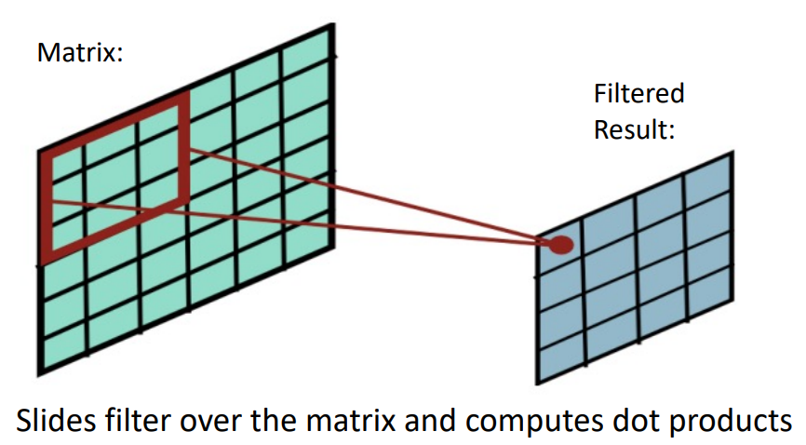
2D Filtering
Compute a function of local neighborhood for each location in matrix
A filter specifies the function for how to combine neighbors’ values
Convolutional Neural Networks
Session 10

Slide 21
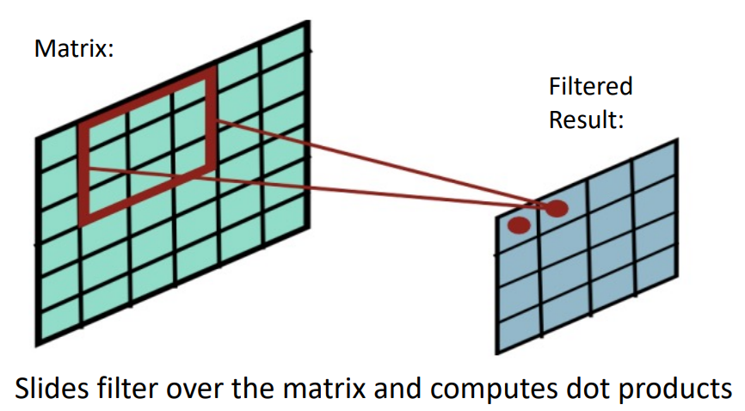
2D Filtering
Convolutional Neural Networks
Session 10

Slide 22
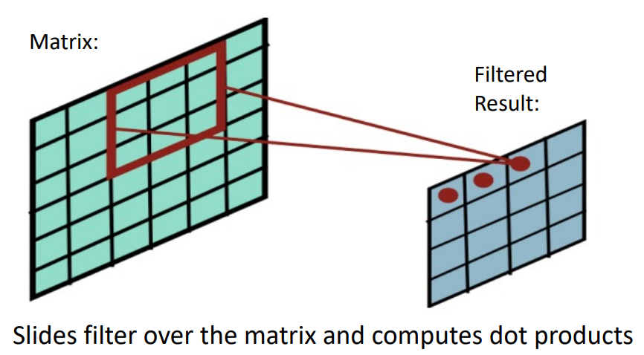
2D Filtering
Convolutional Neural Networks
Session 10

Slide 23
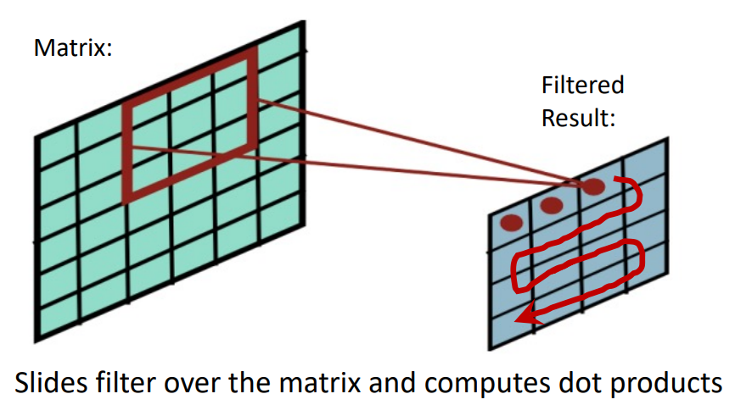
2D Filtering
Convolutional Neural Networks
Session 10

Slide 24
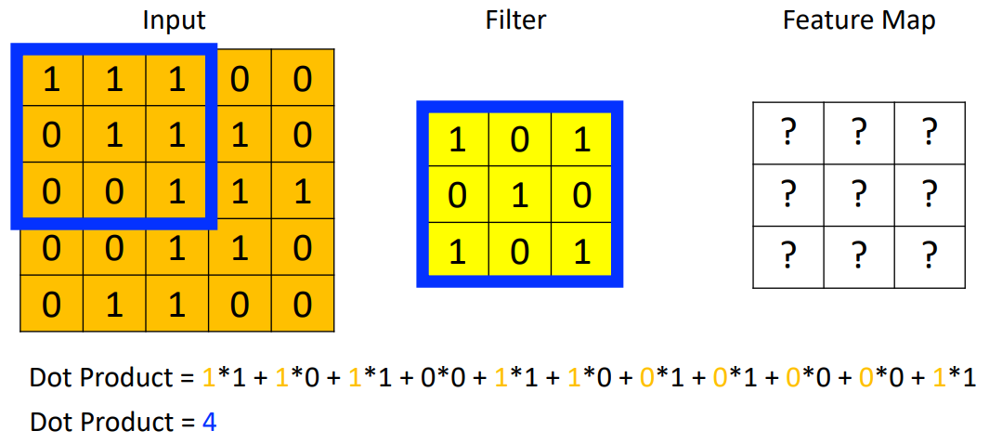
2D Filtering: Example
Convolutional Neural Networks
Session 10

Slide 25
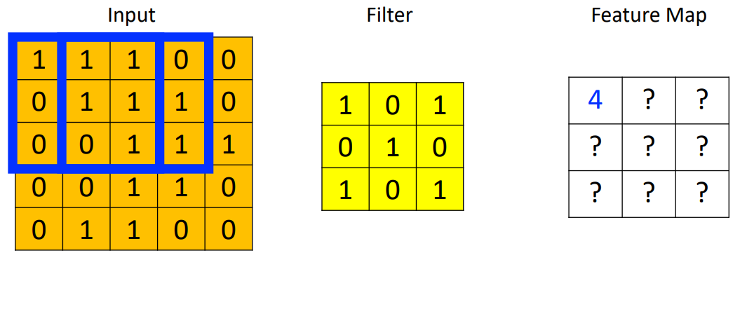
2D Filtering: Example
Convolutional Neural Networks
Session 10

Slide 26
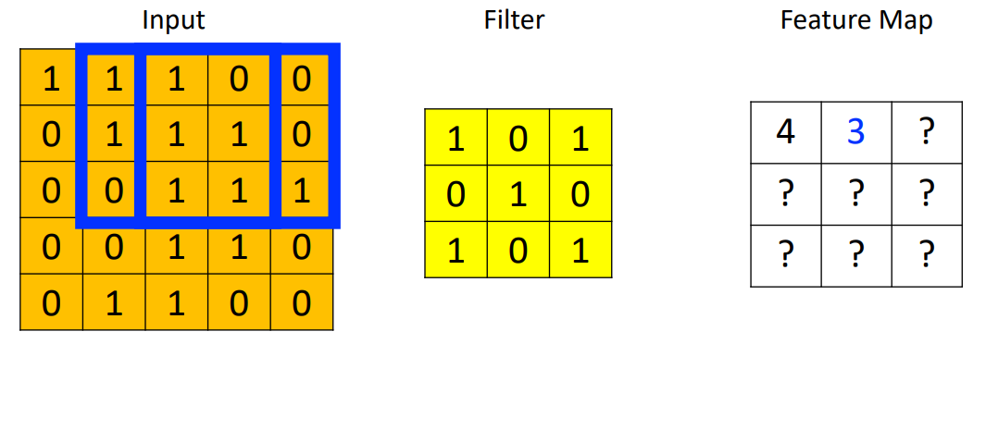
2D Filtering: Example
Convolutional Neural Networks
Session 10

Slide 27
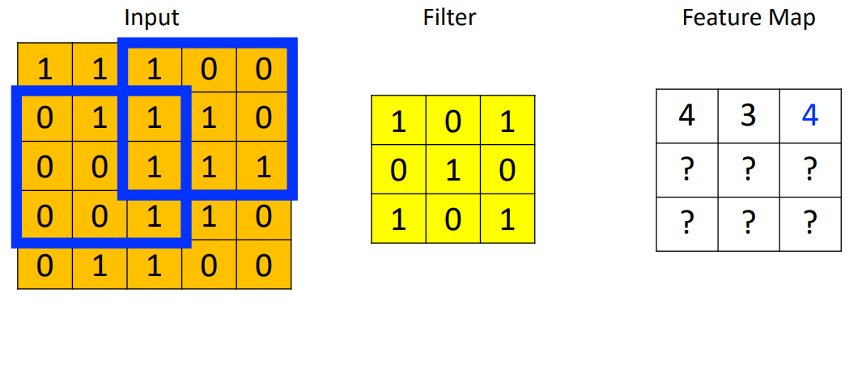
2D Filtering: Example
Convolutional Neural Networks
Session 10

Slide 28
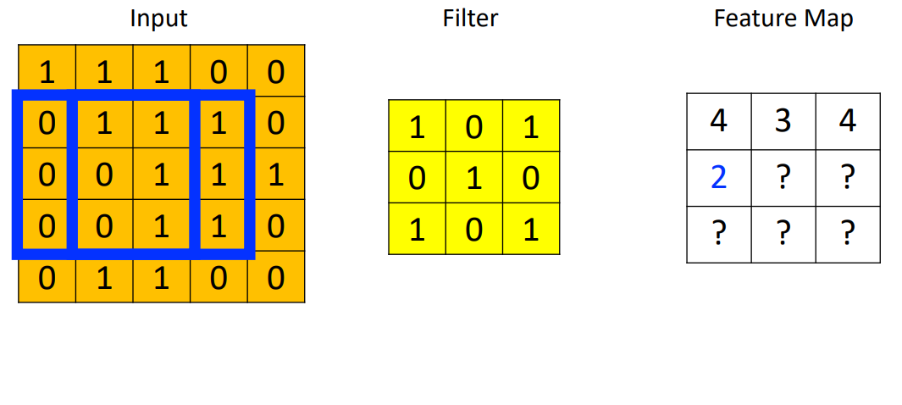
2D Filtering: Example
Convolutional Neural Networks
Session 10

Slide 29
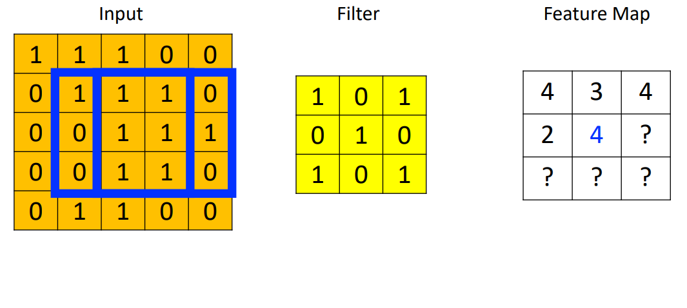
2D Filtering: Example
Convolutional Neural Networks
Session 10

Slide 30
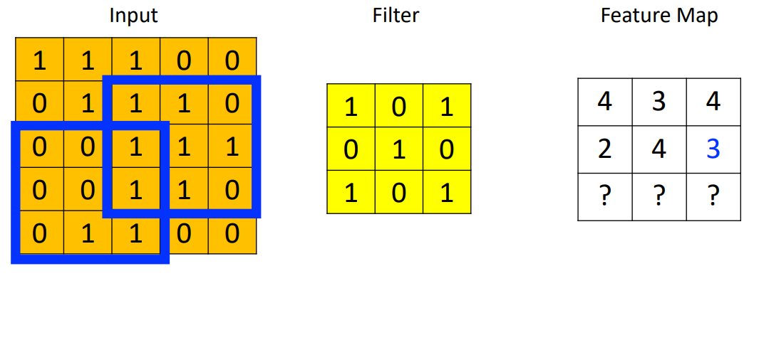
2D Filtering: Example
Convolutional Neural Networks
Session 10

Slide 31
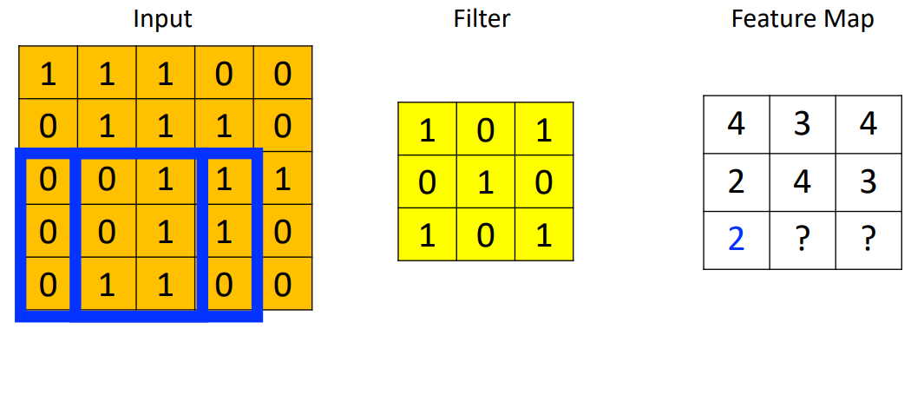
2D Filtering: Example
Convolutional Neural Networks
Session 10

Slide 32
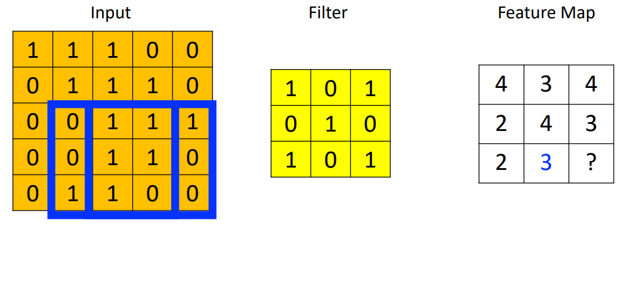
2D Filtering: Example
Convolutional Neural Networks
Session 10

Slide 33
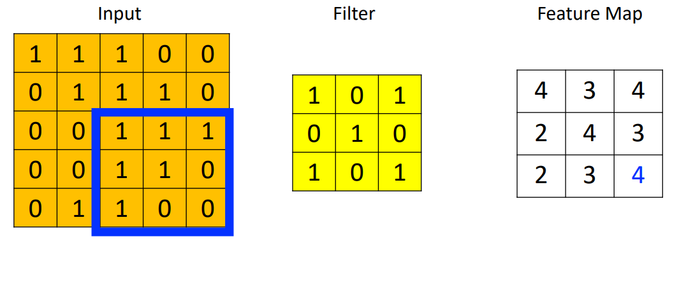
2D Filtering: Example
Convolutional Neural Networks
Session 10

Slide 34
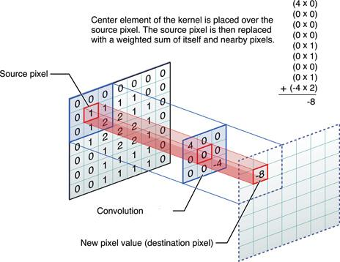
Convolution
https://medium.com/@bdhuma/6-basic-things-to-know-about-convolution-daef5e1bc411
Convolutional Neural Networks
Session 10

Slide 35
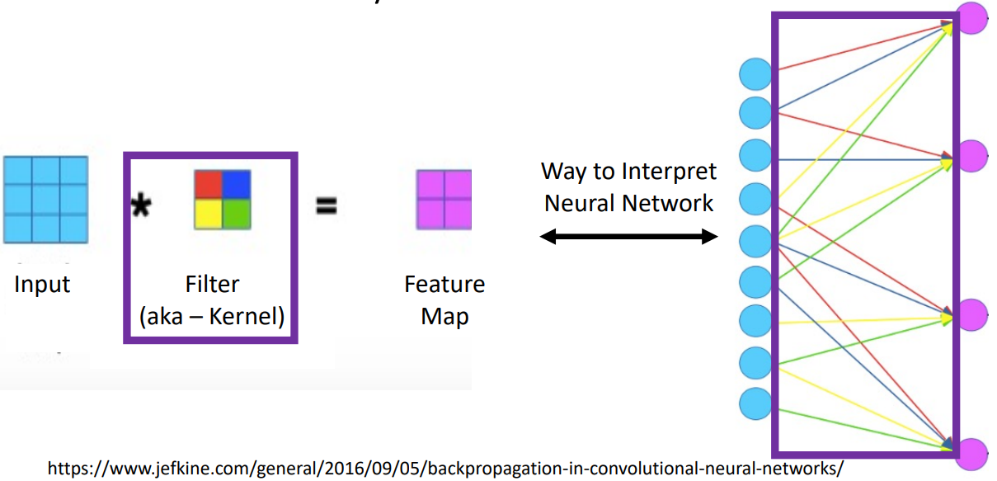
Convolutional Layer: Parameters to Learn
https://www.jefkine.com/general/2016/09/05/backpropagation-in-convolutional-neural-networks/
Convolutional Neural Networks
Session 10

Slide 36
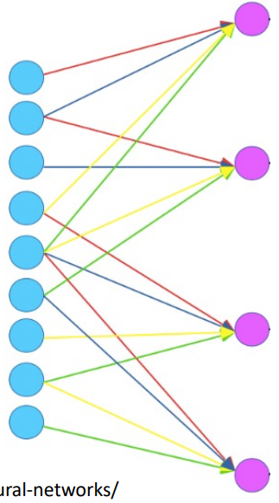
Convolutional Layer: Parameters to Learn
For the shown example, how many weights must be learned?
Convolutional Neural Networks
Session 10

Slide 37
Convolutional Layer: Parameters to Learn
For the shown example, how many weights must be learned?
4 (red, blue, yellow, and green values)
If we instead used a fully connected layer, how many weights would need to be learned?
Convolutional Neural Networks
Session 10

Slide 38
Convolutional Layer: Parameters to Learn
For the shown example, how many weights must be learned?
4 (red, blue, yellow, and green values)
If we instead used a fully connected layer, how many weights would need to be learned?
36 (9 turquoise nodes x 4 magenta nodes)
For shown example, how many parameters must be learned?
Convolutional Neural Networks
Session 10

Slide 39
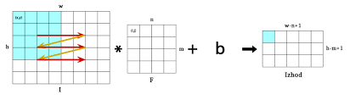
Convolutional Layer: Parameters to Learn
For the shown example, how many weights must be learned?
4 (red, blue, yellow, and green values)
If we instead used a fully connected layer, how many weights would need to be learned?
36 (9 turquoise nodes x 4 magenta nodes)
For the shown example, how many parameters must be learned?
5 (4 weights + 1 bias)
If we instead used a fully connected layer, how many parameters would need to be learned?
Convolutional Neural Networks
Session 10

Slide 40
Convolutional Layer: Parameters to Learn
For the shown example, how many weights must be learned?
4 (red, blue, yellow, and green values)
If we instead used a fully connected layer, how many weights would need to be learned?
36 (9 turquoise nodes x 4 magenta nodes)
For the shown example, how many parameters must be learned?
5 (4 weights + 1 bias)
If we instead used a fully connected layer, how many parameters would need to be learned?
40 (36 weights + 4 bias)
Convolutional Neural Networks
Session 10

Slide 41
Convolutional Layer: Parameters to Learn
Parameter sharing significantly reduces number of parameters to learn and so storage requirements
Sparse connectivity (rather than full) also significantly reduces the number of computational operations required
Convolutional Neural Networks
Session 10

Slide 42
Convolutional Layer: Parameters to Learn
Neocognitron has hard-coded filter values... we will cover models that learn the filter values
Convolutional Neural Networks
Session 10

Slide 43
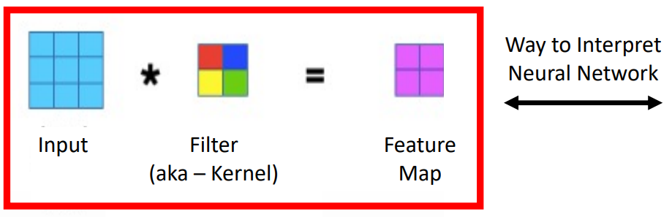
Convolutional Layer
Convolutional Neural Networks
Session 10

Slide 44
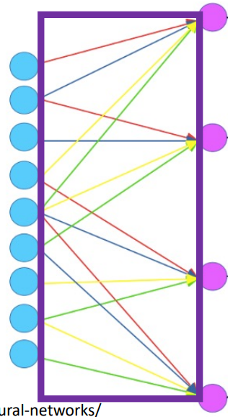
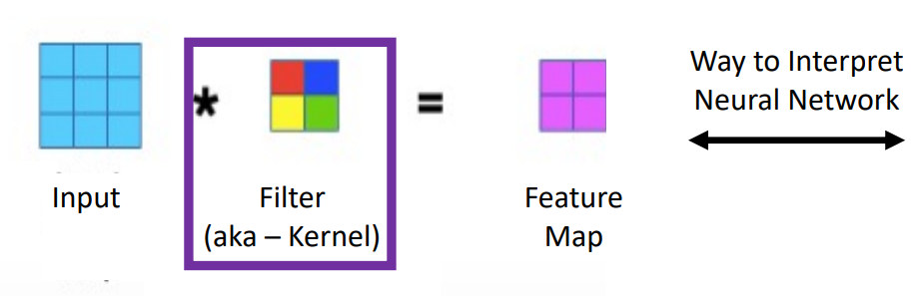
Convolutional Layer
Convolutional Neural Networks
Session 10

Slide 45
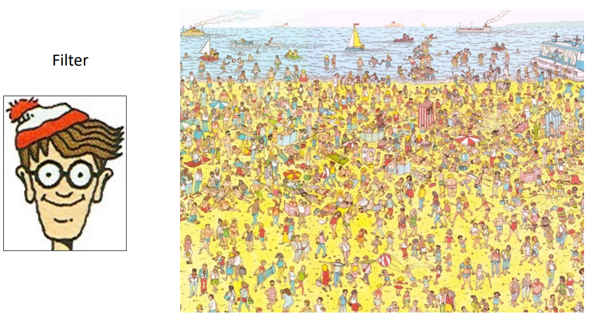
Filter: What Does It Do?
Convolutional Neural Networks
Session 10

Slide 46
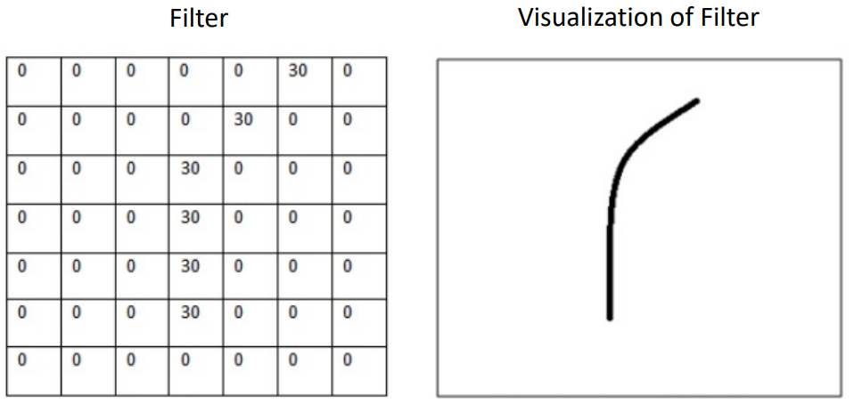
Filter: What Does It Do?
e.g.,
https://adeshpande3.github.io/A-Beginner%27s-Guide-To-Understanding-Convolutional-Neural-Networks/
Convolutional Neural Networks
Session 10

Slide 47
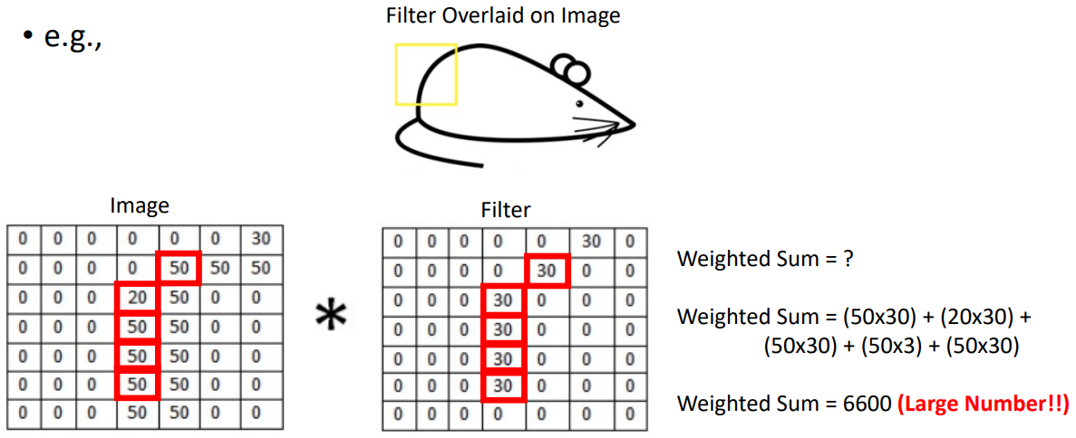
Filter: What Does It Do?
https://adeshpande3.github.io/A-Beginner%27s-Guide-To-Understanding-Convolutional-Neural-Networks/
Convolutional Neural Networks
Session 10

Slide 48
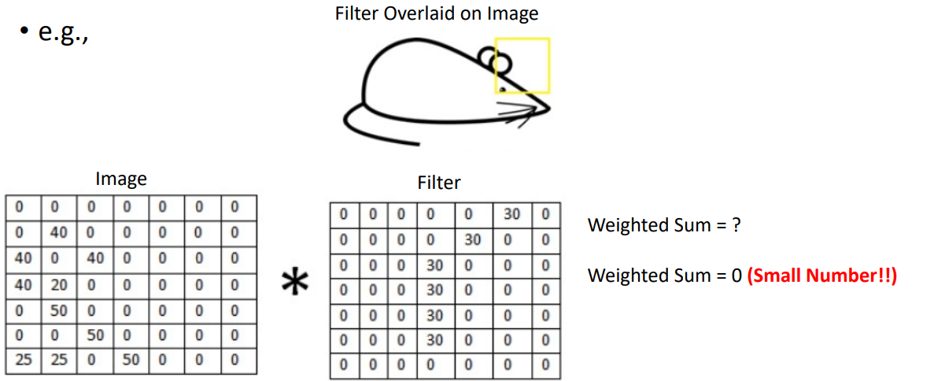
Filter: What Does It Do?
https://adeshpande3.github.io/A-Beginner%27s-Guide-To-Understanding-Convolutional-Neural-Networks/
Convolutional Neural Networks
Session 10

Slide 49
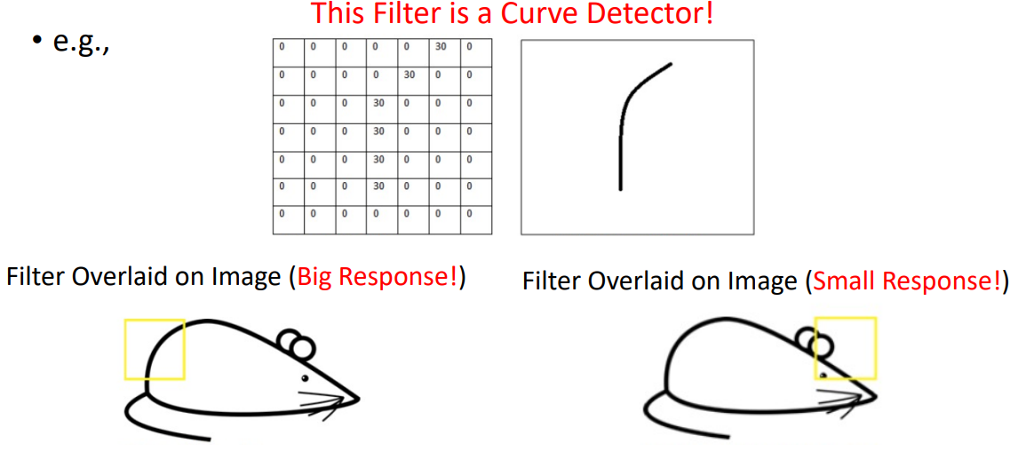
Filter: What Does It Do?
https://adeshpande3.github.io/A-Beginner%27s-Guide-To-Understanding-Convolutional-Neural-Networks/
Convolutional Neural Networks
Session 10

Slide 50

Filters Detect Different Features
https://ujjwalkarn.me/2016/08/11/intuitive-explanation-convnets/
Convolutional Neural Networks
Session 10

Slide 51
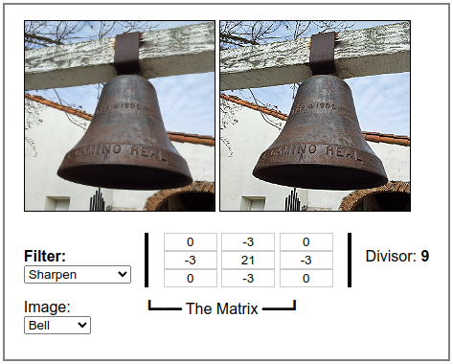
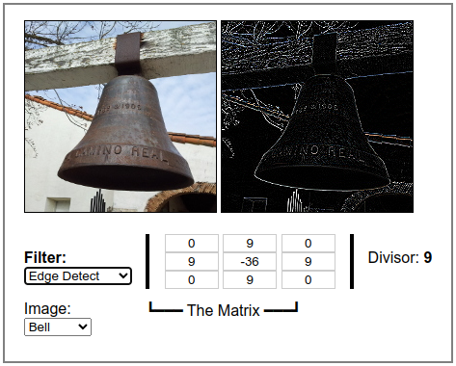
Different Filters Detect Different Features
DEMO: https://beej.us/blog/data/convolution-image-processing/
Convolutional Neural Networks
Session 10

Slide 52
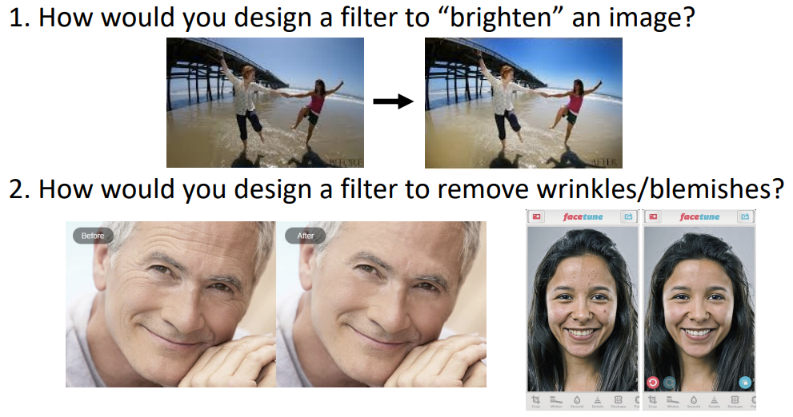
Group Discussion
Convolutional Neural Networks
Session 10

Slide 53
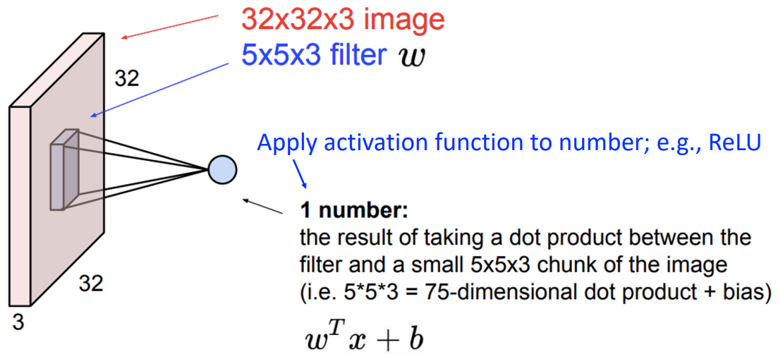
Convolutional Layer
After applying the filter, introduce non-linearity
Convolutional Neural Networks
Session 11

Slide 54
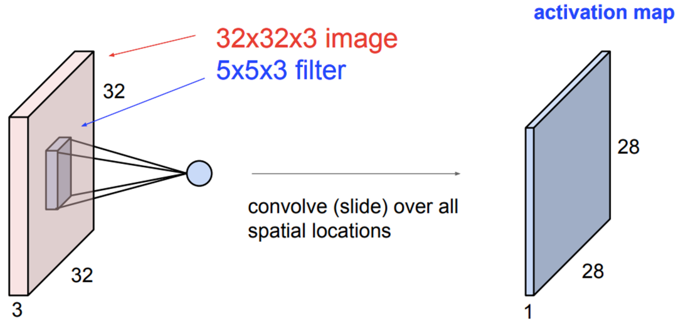
Convolutional Layer
Slide filter across input
Convolutional Neural Networks
Session 11

Slide 55
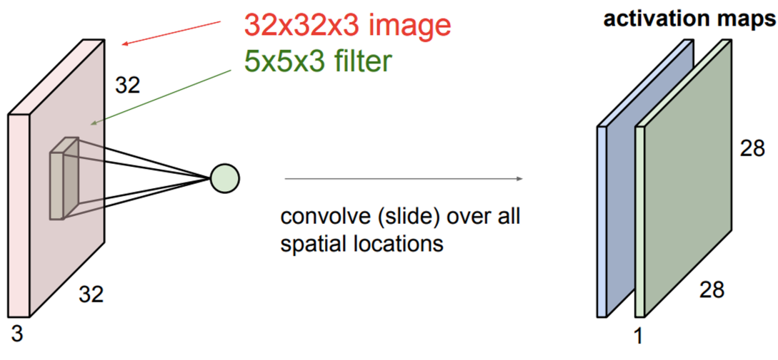
Convolutional Layer
Consider a second, green filter.
Slide filter across input
Convolutional Neural Networks
Session 11

Slide 56
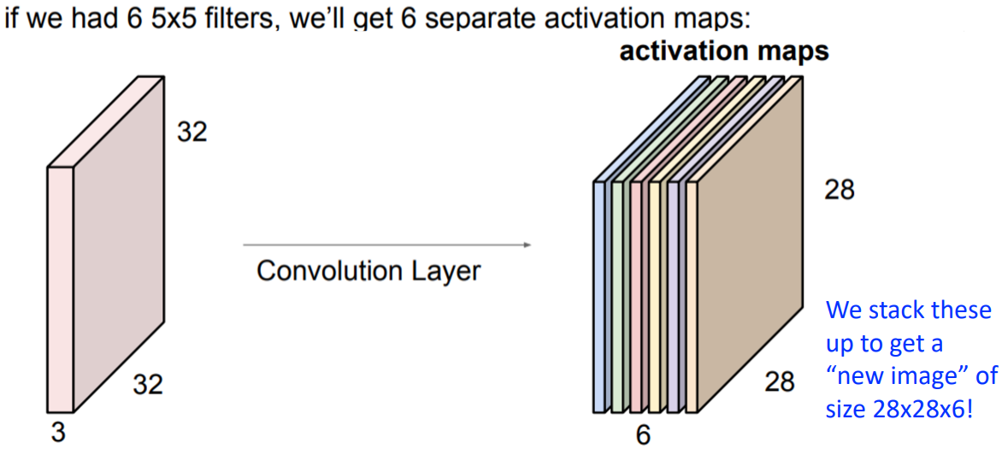
Convolutional Layer
Convolutional Neural Networks
Session 11

Slide 57
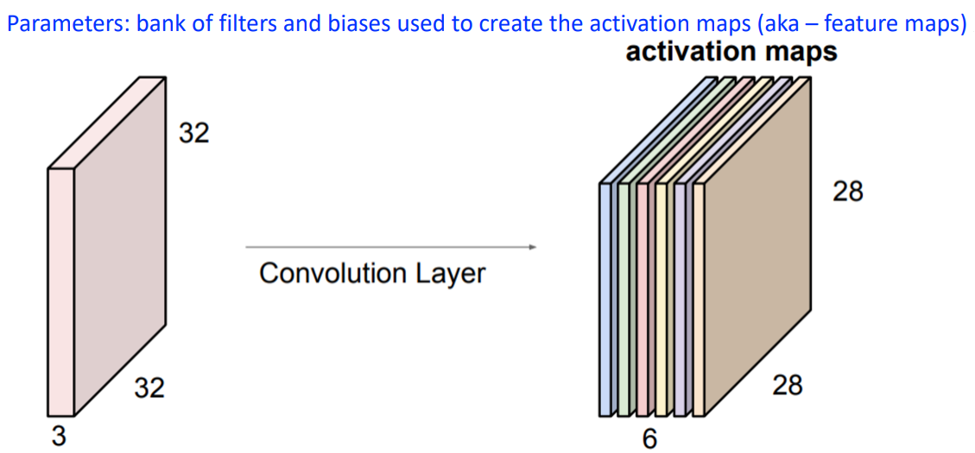
Convolutional Layer: Parameters to Learn
Convolutional Neural Networks
Session 11

Slide 58
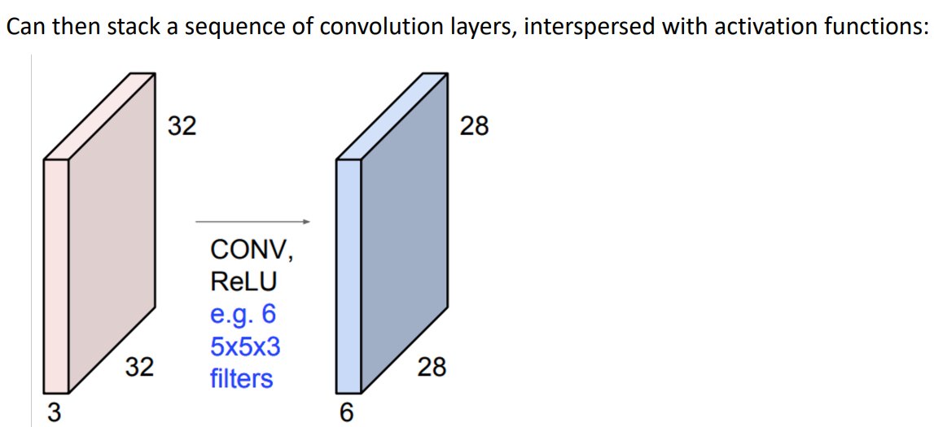
Convolutional Layers Stacked
Convolutional Neural Networks
Session 11

Slide 59
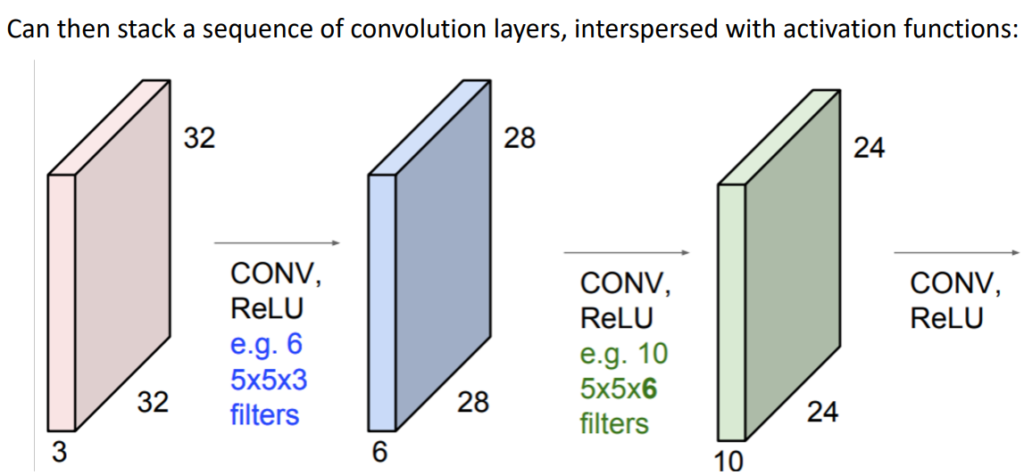
Convolutional Layers Stacked
Convolutional Neural Networks
Session 11

Slide 60

Convolutional Layers Stacked
Convolutional Neural Networks
Session 11

Slide 61

Convolution: Implementation Details
Padding: add values at the boundaries to control output size
Convolutional Neural Networks
Session 11

Slide 62

Convolution: Implementation Details
Stride: how many steps taken spatially before applying a filter
e.g., 2x2
Convolutional Neural Networks
Session 11

Slide 63
Parameters vs Hyperparameters in Convolutional Layers
Hyperparameters:
?
?
?
Parameters:
?
?
Convolutional Neural Networks
Session 11

Slide 64
Parameters vs Hyperparameters in Convolutional Layers
Hyperparameters:
Number of filters and their dimensions (height and width)
Stride
Padding type
Parameters:
Weights
Biases
Convolutional Neural Networks
Session 11

Slide 65

Pooling Layer
Makes the representations smaller and more manageable
Helps retain important information while discarding unnecessary details.
Introduces some invariance to
small translations or distortions
(e.g., slight shifts in the image).
Operates over each activation
map independently:
Convolutional Neural Networks
Session 11

Slide 66

Types of Pooling
Max-pooling: partitions input into a set of non-overlapping (generaly) rectangles and outputs the maximum value for each chunk
Convolutional Neural Networks
Session 11

Slide 67
Types of Pooling
Max-pooling: partitions input into a set of non-overlapping (generaly) rectangles and outputs the maximum value for each chunk
Convolutional Neural Networks
Session 11

Slide 68

Types of Pooling
Average-pooling: partitions input into a set of non-overlapping (generaly) rectangles and outputs the average value for each chunk
Convolutional Neural Networks
Session 11

Slide 69
Types of Pooling
Average-pooling: partitions input into a set of non-overlapping (generaly) rectangles and outputs the average value for each chunk
20
Convolutional Neural Networks
Session 11

Slide 70

Pooling Layer
Resilient to small translations
e.g.,
Input: all values change (shift right)
Output: only half the values change
Convolutional Neural Networks
Session 11

Slide 71
Pooling Layer: Benefits
How many parameters must be learned?
None
Benefits?
Builds in invariance to translations of the input
Reduces memory requirements
Reduces computational requirements
Convolutional Neural Networks
Session 11

Slide 72

Convolutional Neural Networks
Convolution: apply filters to generate feature maps;
Non-linearity: Often ReLU;
Pooling: Downsampling operation on each feature map.
Train model with image data.
Learn weights of filters in convolutional layers.
Convolutional Neural Networks
Session 11

Slide 73

Convolutional Neural Networks
For a neuron in hidden layer:
Take inputs from patch
Compute weighted sum
Apply bias
Applying a window of weights
Computing linear combinations
Activating with non-linear function
Convolutional Neural Networks
Session 11

Slide 74

Convolutional Neural Networks
Convolutional Neural Networks
Session 11

Slide 75


Convolutional Neural Networks
Introducing non-linearity.
Apply after each convolutional layer
ReLU: pixel-by-pixel operation that replaces all negative values by zero.
Non-linear operation!
Convolutional Neural Networks
Session 11

Slide 76

Representation Learning in Deep CNNs
Convolutional Neural Networks
Session 11

Slide 77

CNNs for Classification: Feature Learning
Learn features in input image through convolution
Introduce non-linearity through activation function (real worl data is non-linear!)
Reduce dimensionality and preserve spatial invariance with pooling
Convolutional Neural Networks
Session 11

Slide 78

CNNs for Classification: Predictions
CONV and POOL layers output high-level features of input
Fully connected layers uses these features for classifying input image
Express output as probability of image belonging to a particular class
Convolutional Neural Networks
Session 11

